Slide 1
Breast Cancer Dataset Analysis
Akshat Bharadwaj
The LNMIIT, Jaipur

Slide 2
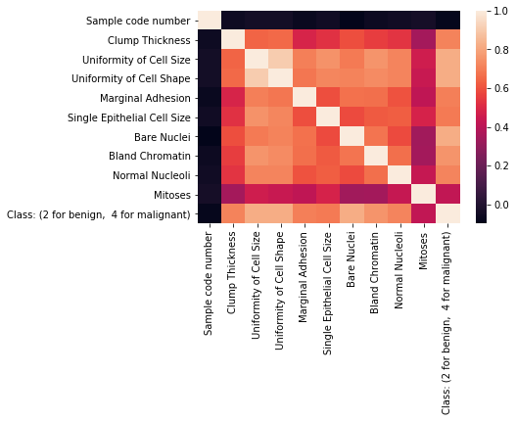
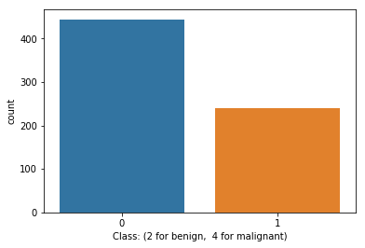
Dataset, and Features:
We had to predict whether the breast tumor sample was benign or malignant.
Graphical Analysis:
The dataset was mildly imbalanced.
Features were heavily correlated.

Slide 3
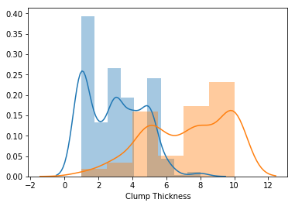
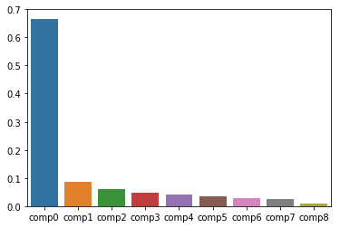
Since the features were easily distinguishable, and all seemed to have a reasonable impact on the target variable, we fed them all for the predictions.
(We did try chi2 filtering, but the results were generally worse).
Classes(benign/malignant) were easily distinguishable.
We decomposed the dataset into its principal components, and chose the first 6 components using PCA to further increase our prediction accuracy.

Slide 4
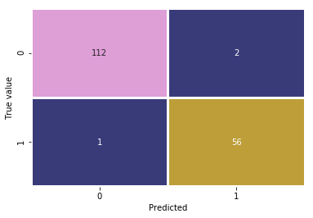
Predictions: We used a wide variety of algorithms such as GBC, SVC, MLPClassifier etc but the best results were given by Random Forests, paired with PCA.
Random Forest is an ensemble method that combines a multitude of decision trees to arrive at a better result than individual decision trees. It adds additional randomness to the model, while growing the trees. Instead of searching for the most important feature while splitting a node, it searches for the best feature among a random subset of features. This results in a wide diversity that generally results in a better model. It uses GINIindex, etc to split the node. We ran the vanilla classifier with no hyperparameter tuning for the results. It surely would give better results if we tune it a bit.
PCA is used for dimensionality reduction, as it makes new features out of the existing features on a separate plane, and then we can select the features which explain the maximum variations in our data.
For the second task, we used confusion matrices and used SVC’s predict_proba function to get the probabilities of the malignant predictions, and used an experimental threshold to gradually maximise the positive predictions to reduce chances of False Negatives.

Slide 5
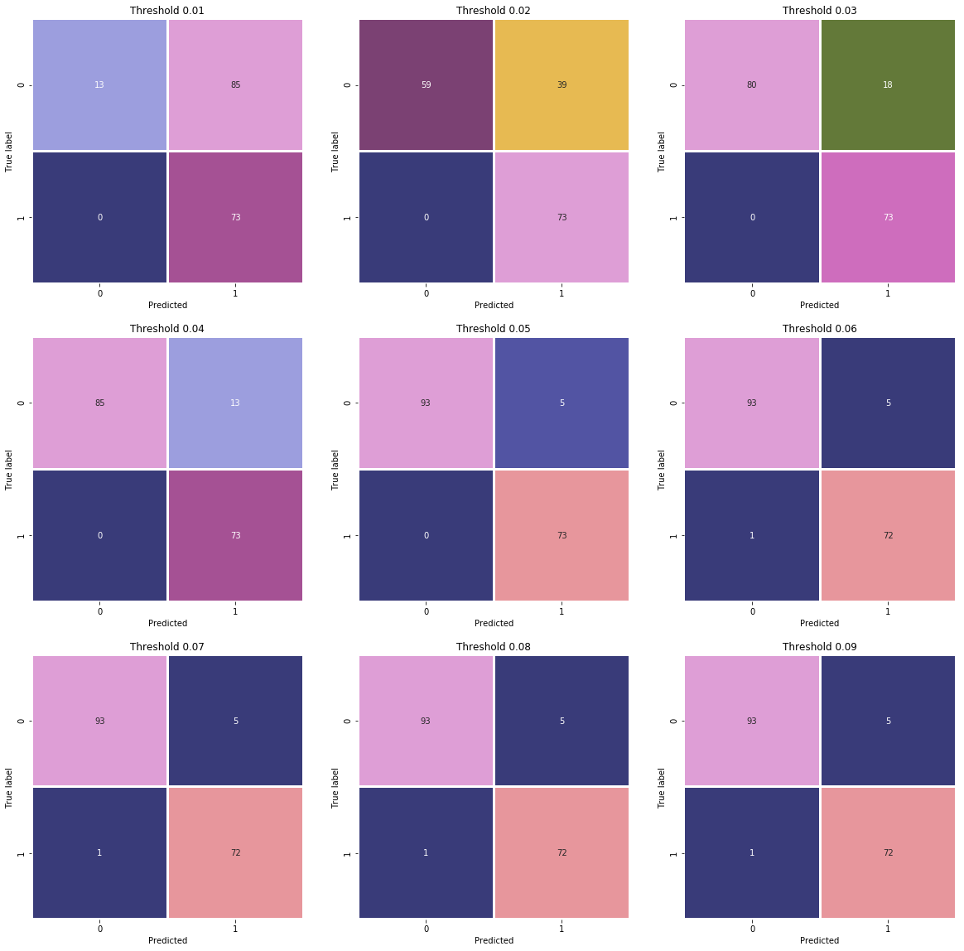
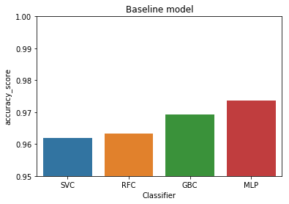
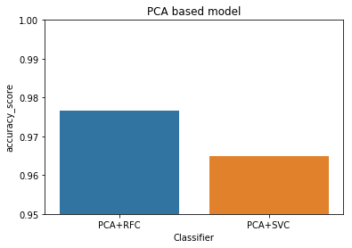
Results: We measured accuracy using accuracy_score, and used Recall for minimising FNs.
We got the best result using RandomForestClassifier + PCA.
We obtained the threshold value for bring FNs to zero at 0.05.
FNs(Dark Blue) = 0

